Slide 1

Cyclistic
case study

Slide 2
Hello!
I am Abhijit Kurade.
e-mail : abhijit.kurade2000@gmail.com
Linkedin : www.linkedin.com/in/abhijit-kurade
Github : github.com/Abhijitkurade

Slide 3
background
In 2016, Cyclistic launched a successful bike-share offering. Since then, the program has grown to a fleet of 5,824 bicycles that are geo-tracked and locked into a network of 692 stations across Chicago. The bikes can be unlocked from one station and returned to any other station in the system anytime.
There are two types of cyclists, those who purchase casual tickets and those purchase annual memberships. The marketing team believes that maximizing the number of annual members will be key to future growth. Rather than creating a marketing campaign that targets all-new customers, there is a very good chance to convert casual riders into members.

Slide 4

Project purpose
What is the most effective marketing strategy of converting Cyclistic's casual riders to annual member ?
How do annual members and casual riders use Cyclistic bikes differently?
Single Pass purchasers
Annual subscribers

Slide 5
Key findings: Count Of Rides By Day Of Weeks
Sunday
Saturday

Slide 6
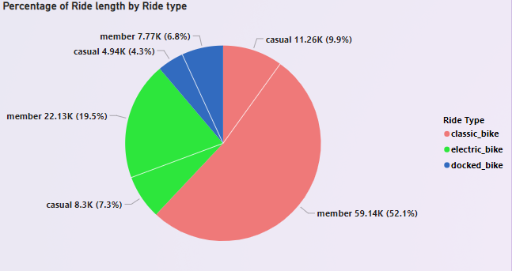
Key Finds: People’s Favorite Ride Type

Slide 7
Key Finds: Average Ride Length By Riders

Slide 8

Key Findings: Summary
The days of week also further shows that causal riders prefer to use the service during the weekends as their usage at peak. The long term members conversely utilized the service throughout the typical work week i.e (Monday- Friday)
Long term riders tended to stick to classic bikes as opposed to the docked or electric bikes. This might suggest more available classic bikes or the pricing between each option might be a factor

Slide 9

Next Possible Steps:
Try new service and pricing models like:
Optimize profits by focusing on factors affecting Casuals willingness to pay.
Yearly subscription providing an unlimited pass for every weekend.
Introduces a middle pricing tier that could be the basis for pricing optimization or reduce membership cost.

Slide 10
Our Proposal
Apply what we know from our initial findings to kickstart and form the basis of Cyclistic's marketing conversion strategies.
We know how Casuals and Members use Cyclistic bikes differently, but not conclusively why?
A more examination is necessary for an effective conversion strategy

Slide 11

Sources:
Data Source
amazonaws.com/202012-divvy-tripdata
last updated on: 2 oct 2022

Slide 12

Thank you

